Slide 1

VueJS
Course Introduction
SoftUni Team
Technical Trainers
Software University
https://softuni.bg

Slide 2

Table of Contents
Course Overview
Course Objectives
Course Topics
Training Team
Course Organization

Slide 3
Questions
sli.do #js-frameworks

Slide 4
Course Objectives
The VueJS course provides
Basic understanding of VueJS
Covers component-based architecture
What is NOT covered?
JavaScript basics and syntax
REST communication fundamentals
4

Slide 5
Warning: Not for Absolute Beginners
The "VueJS" course is NOT for absolute beginners
Requirements
HTML & JS (ES 2016) coding skills - intermediate level
If you want, you can take the HTML and CSS Course
Computer English - entry level
5

Slide 6
Course Topics
Intro to VueJS - Overview, Installation, Vue Instance and Templates
Directives and Event Handling - Conditional rendering, List rendering, Methods, Watchers
Components - Props, Emitting Events and Slots
Forms and Validators - Handling Forms, Validation and Vuelidate

Slide 7
Course Topics (2)
Filters, Mixins, HTTP - Transforming data, Connecting to a server
SPA and Routing - Vue router, Guards, Data fetching
State Management - Vuex, State, Getters, Mutations and Actions

Slide 8

Training Team

Slide 9

Ilia Idakiev
Software developer-entrepreneur
Co-Founder @ HILLGRAND
Google Developer Expert
Co-organizer of Angular Sofia and SofiaJS / BeerJS
Lecturer at Sofia University (FMI)
"Advanced JavaScript" course

Slide 10
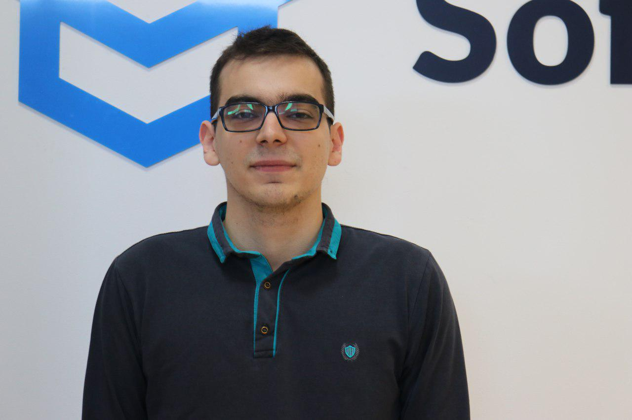
Kiril Kirilov
Program Lead @ SoftUni
Involved with programming since high-school
Passionate about .NET, JavaScript, Angular
Currently studying Math & Informatics at Sofia University (FMI)

Slide 11

Course Organization

Slide 12

Training Duration
Lessons: ~30 hours (onsite + videos)
Practical Workshop (in class): ~30 hours
Project Defense: ~15 minutes
Defense date: 11 April 2020
Retake defense date: 16 April 2020

Slide 13



Scoring System for the Course
Theoretical Exam 5%
Project Defense 95%
Bonus up to 10%
Evaluation

Slide 14
Theoretical Exam
You will have 30 minutes once you enter
Multiple-choice with 1 correct answer
English
Automated quiz system
Available online the same day as the practical exam
You can submit your answers just one time

Slide 15


Learn to Search Online
The course assignments require searching online
This is an important part of the learning process
Some exercises intentionally have no hints
Learn to find solutions!
Software development includes everyday searching and learning
No excuses, just learn to study!
Developers learn new technologies, tools, languages every day!

Slide 16
Questions?
Notes:
16

Slide 17












SoftUni Diamond Partners

Slide 18




SoftUni Organizational Partners

Slide 19
Trainings @ Software University (SoftUni)
Software University – High-Quality Education, Profession and Job for Software Developers
softuni.bg, softuni.org
Software University Foundation
softuni.foundation
Software University @ Facebook
facebook.com/SoftwareUniversity
Software University Forums
forum.softuni.bg
19
Notes:
19

Slide 20

License
This course (slides, examples, demos, exercises, homework, documents, videos and other assets) is copyrighted content
Unauthorized copy, reproduction or use is illegal
© SoftUni – https://softuni.org
© Software University – https://softuni.bg
Notes:
20

